Slide 1
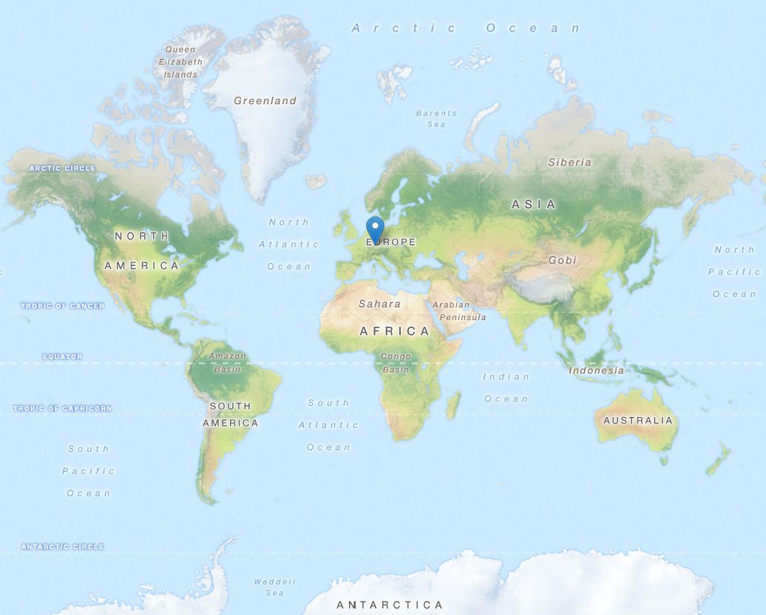
Balanced Geohash Partitioning and Efficient Retrieval of Geospatial Big Data on Distributed and Parallel Platforms (Apache SparkTM)

Slide 2
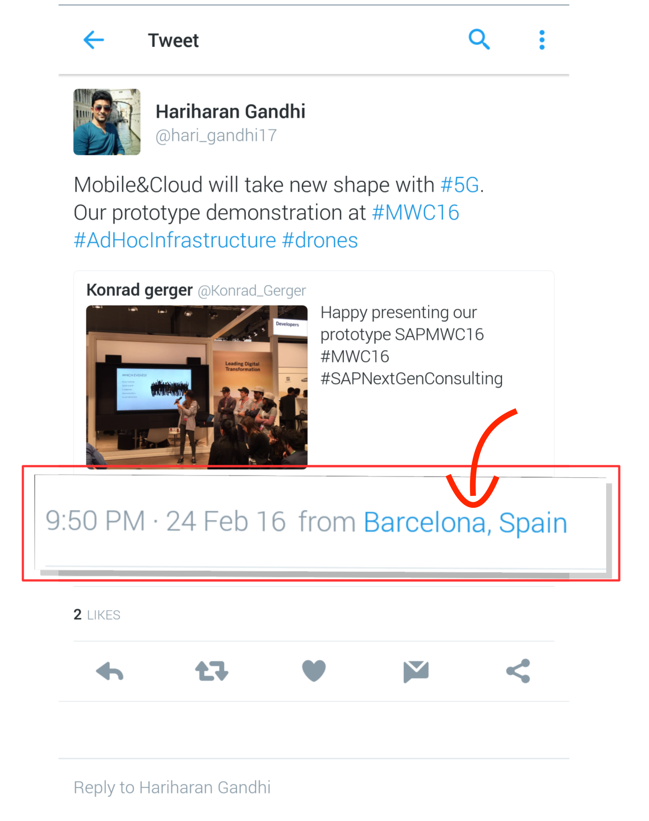
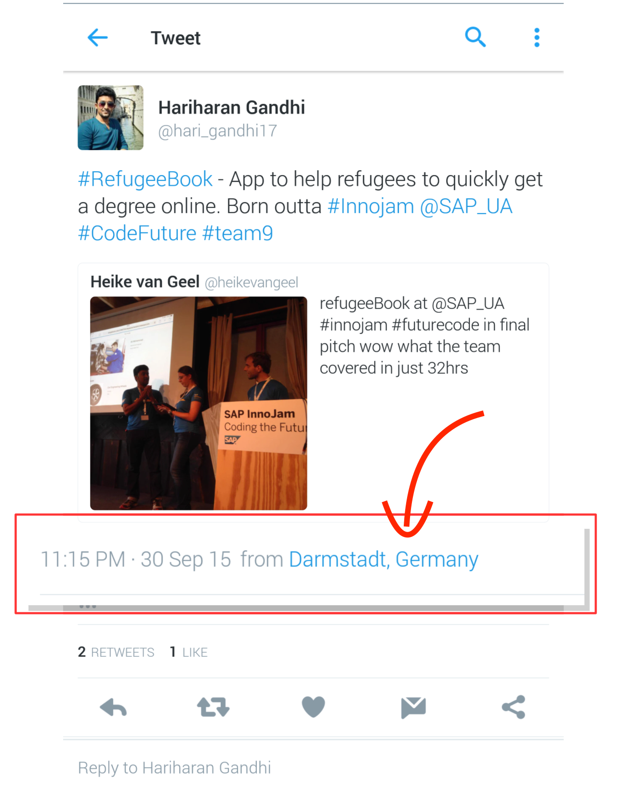
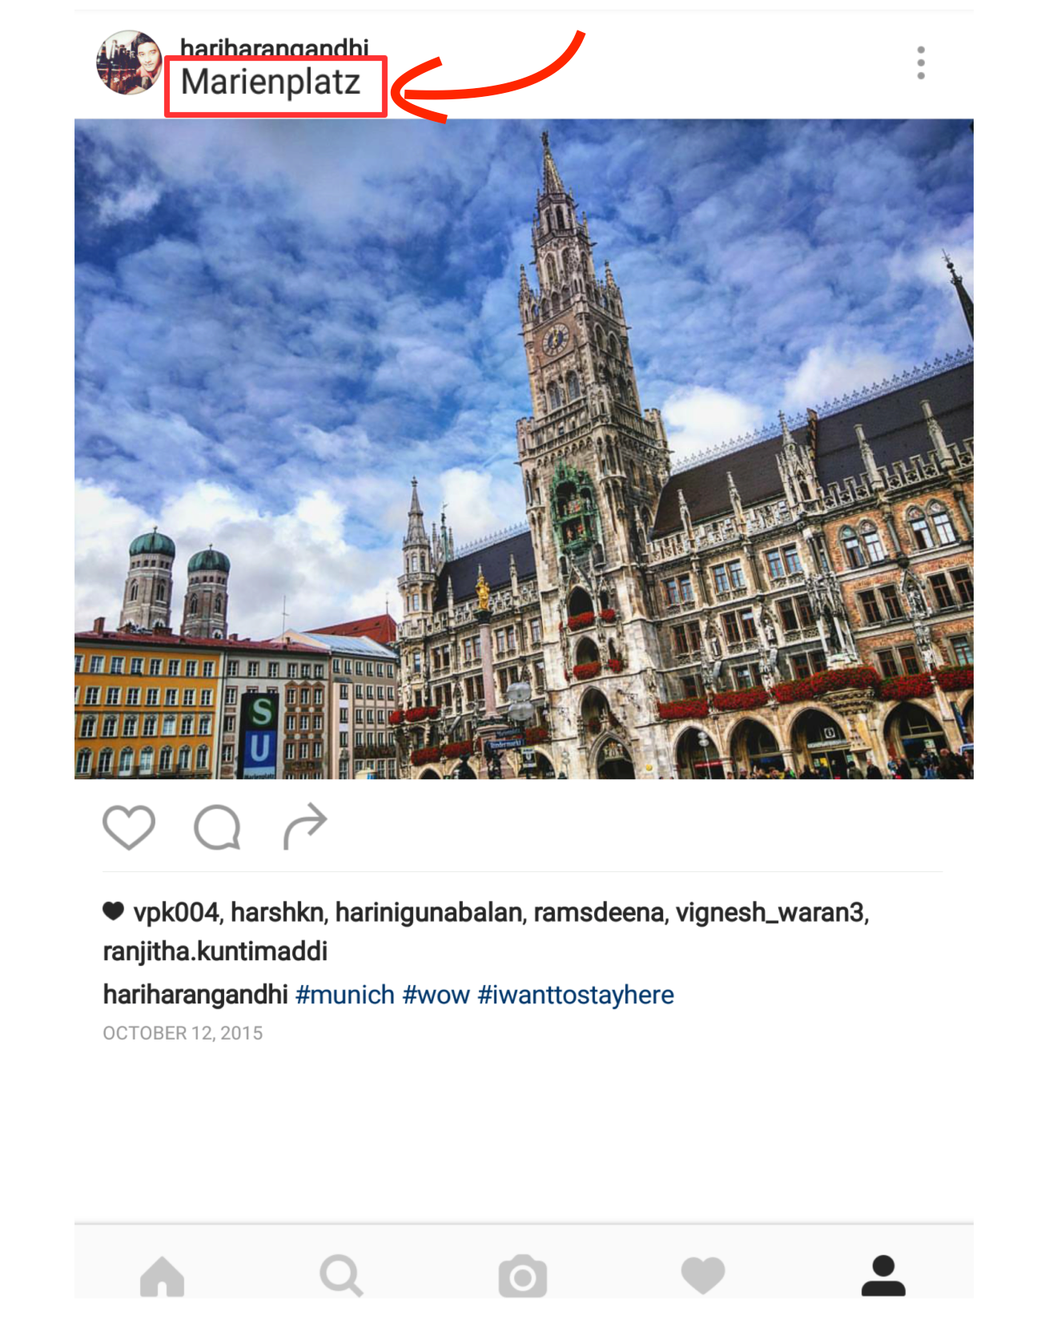
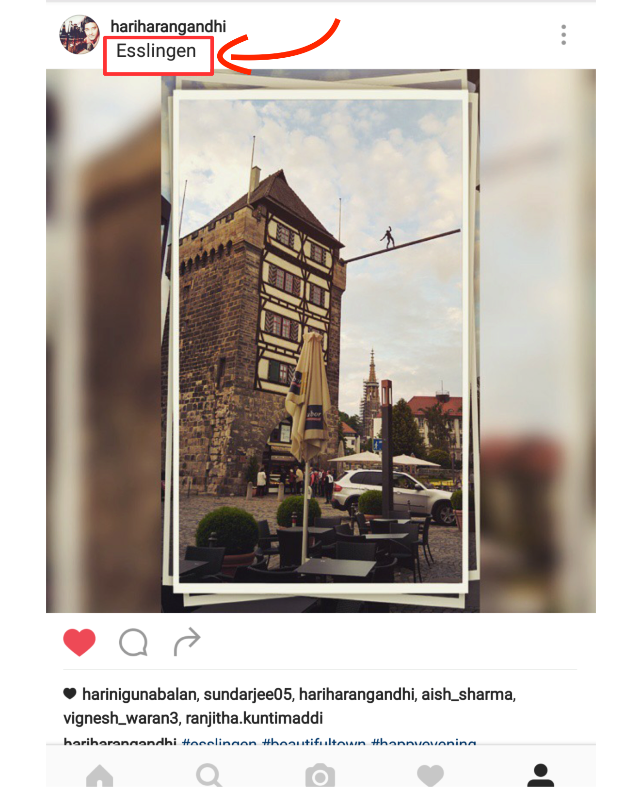
Notes:
7/13/16
2
2

Slide 3
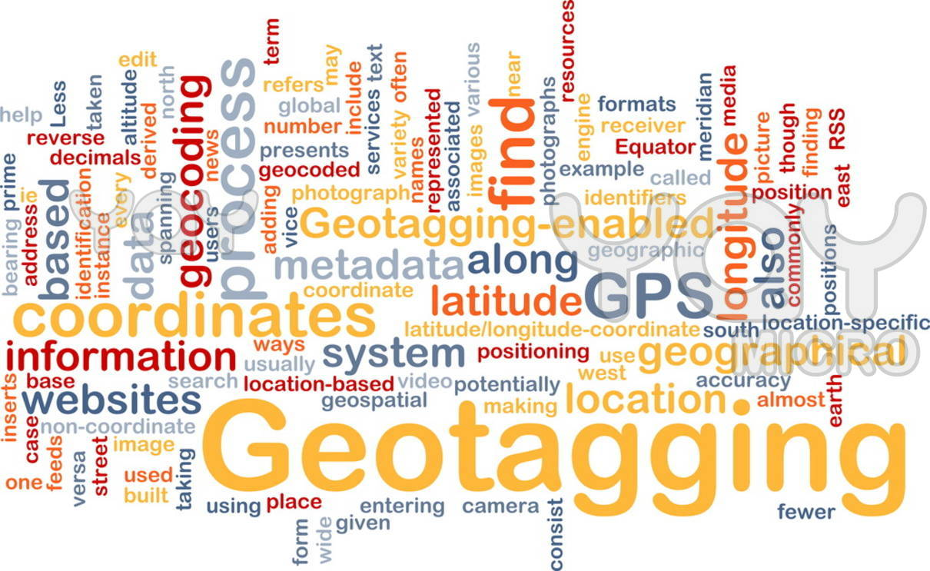







7.6 Billion / 4.7 Billion unique - 2015
Notes:
7/13/16
3
3

Slide 4
Trending Scenario
Very large volume of Geo-spatial data
Businesses need location aware services like,
tweets in an particular area
weather information of a holiday spot which you plan to visit over the vacation
Attractions nearby
Take me through the shortest route
many more.....
Notes:
7/13/16
4
4

Slide 5

Seek support from Parallel computing platforms
To handle such large volumes
But unfortunately, no native support (yet)
Needs modifying internal implementations
Notes:
7/13/16
5
5

Slide 6

Why partition ?
Spatial Indexing for retrieval
Range Queries, grouping – Network cost due to shuffling between clusters/nodes
Notes:
7/13/16
6
6

Slide 7
When to partition ?
Geospatial operations intense application,. Eg: Location aware services
Major interests of queries are Geospatial:
Ex: Maps, Uber, Jodel, AirBnB, Emergency Services
Multiple reads
Notes:
7/13/16
7
7

Slide 8
The plan
Introduce a partitioning scheme in Apache Spark that partitions data-sets considering Geo-spatial info:
Communication in distributed environment:
minimize network traffic by allowing spark program to control RDD partitioning
Retained Spatial Locality:
nearby points are probably in the same partition / cluster
Minimize data points shuffling during Geo-spatial queries
Optimized for Search & Range queries on Geo-points
Notes:
7/13/16
8
8

Slide 9
Efficient Spatial processing with Spark
GeoHash Partitioner
GeoHash Query Layer
Notes:
7/13/16
9
9

Slide 10
GeoHash Partitioner
Notes:
7/13/16
10
10

Slide 11
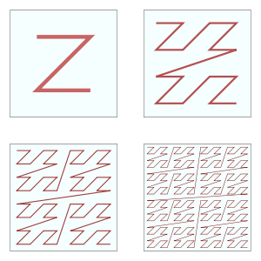

Space Filling Curves
Z-order Curve
Hilbert Curve
Notes:
7/13/16
11
11

Slide 12
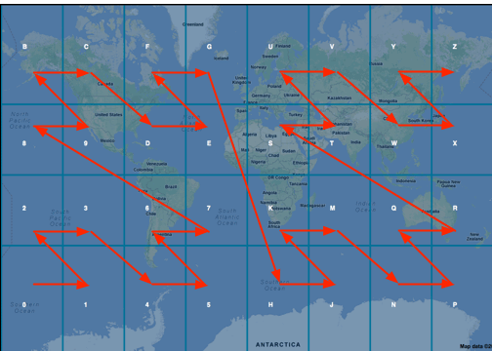
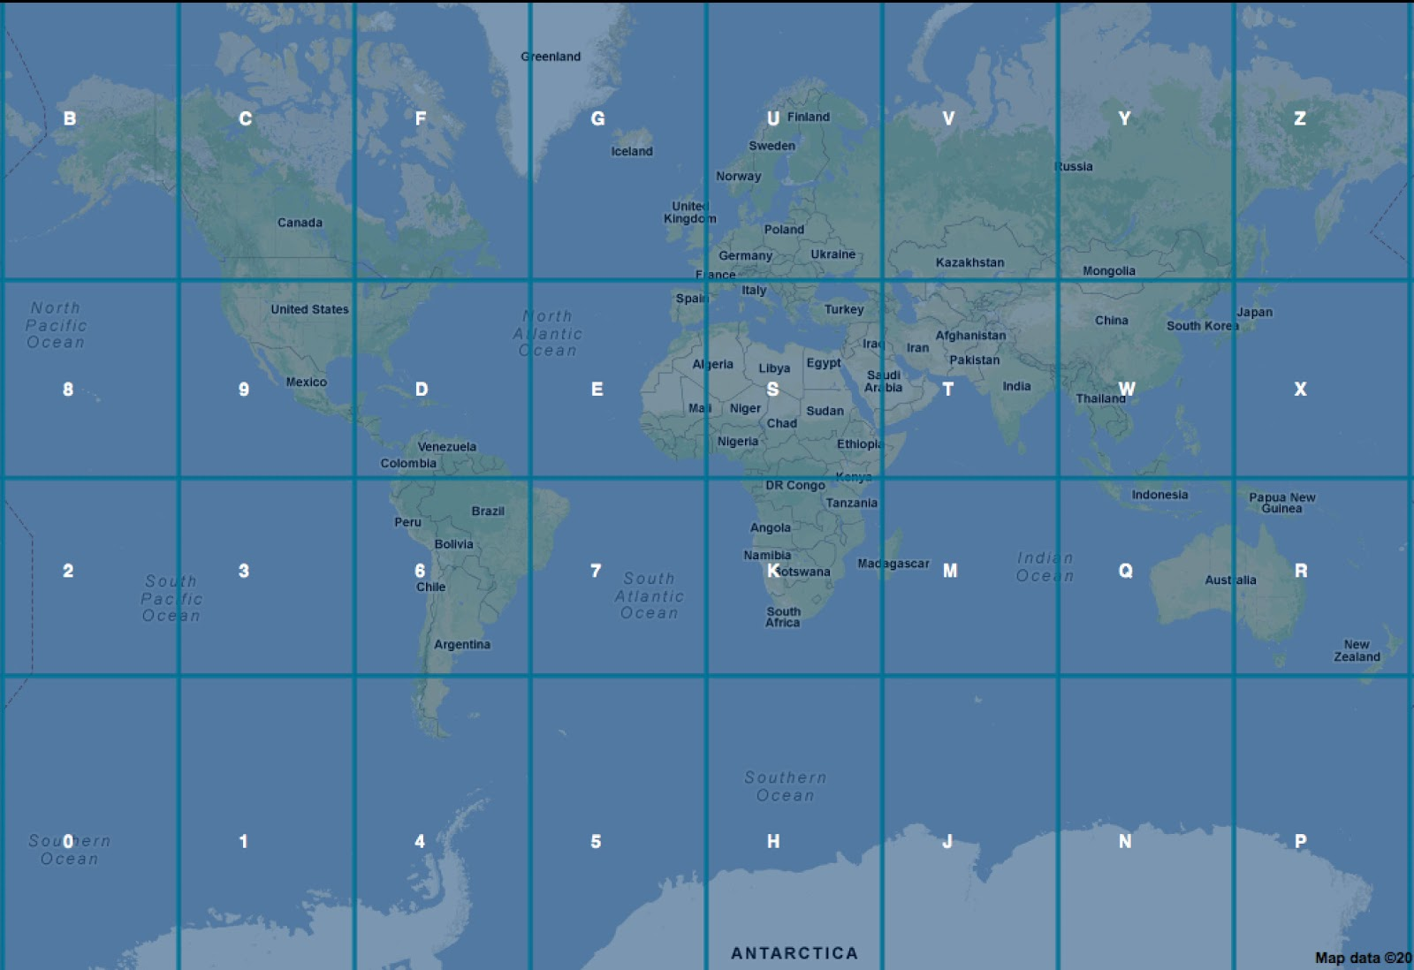
GeoHash
Notes:
7/13/16
12
12

Slide 13
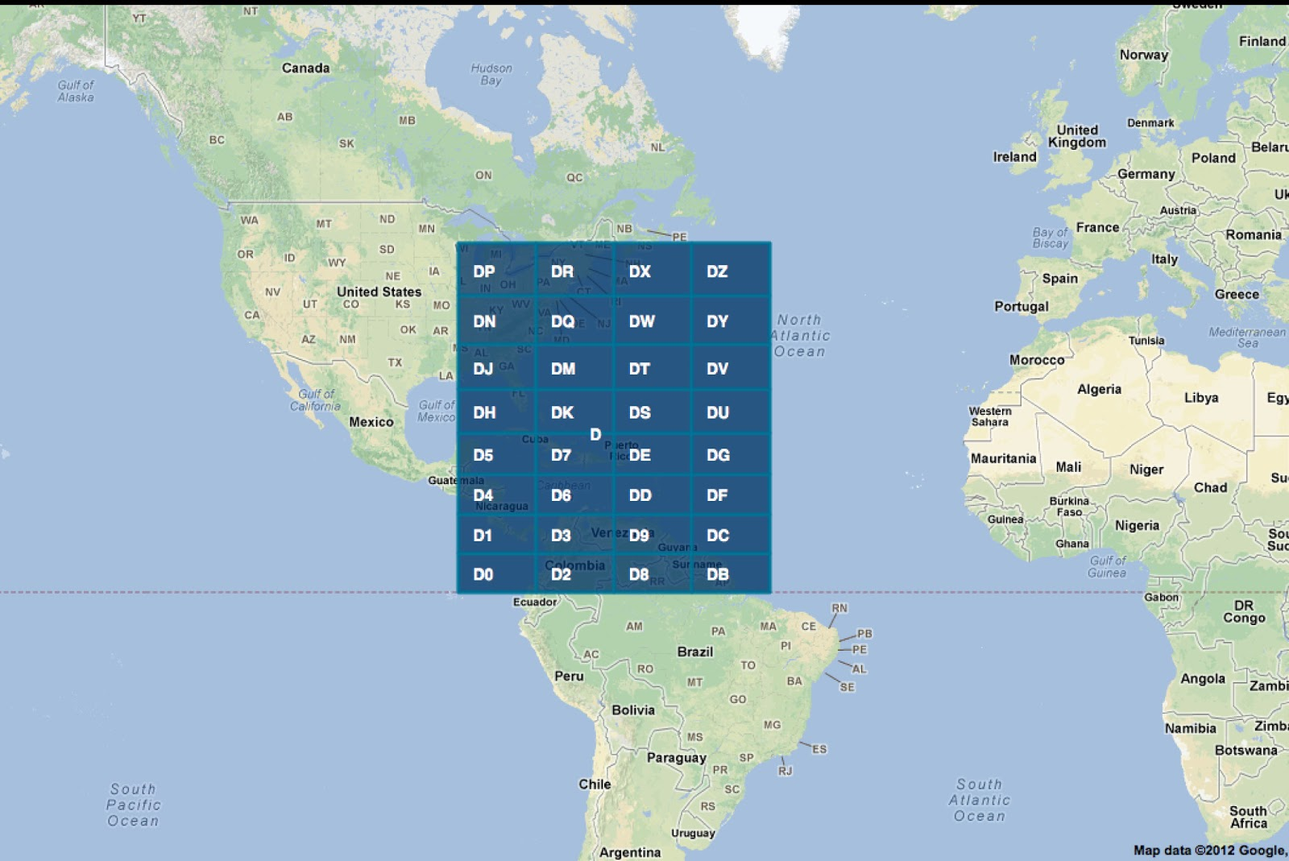
GeoHash
Notes:
7/13/16
13
13

Slide 14
GeoHash Partitioner
Notes:
7/13/16
14
14

Slide 15
Notes:
7/13/16
15
15

Slide 16
Notes:
7/13/16
16
16

Slide 17
Variable length
So now we need to map to nodes
This variable length grids are mapped on to a data structure
dr
Prefix
5
7
r
2
Partition
number
Partition
number
Partition
number
Notes:
7/13/16
17
17

Slide 18
Custom Partitioning
Step1: Load Aware
Step2: Variable length to generate Hash
Step3: Map these hash to RDD partitions
Step4: Distribute or lay out data accordingly
Notes:
7/13/16
18
18

Slide 19
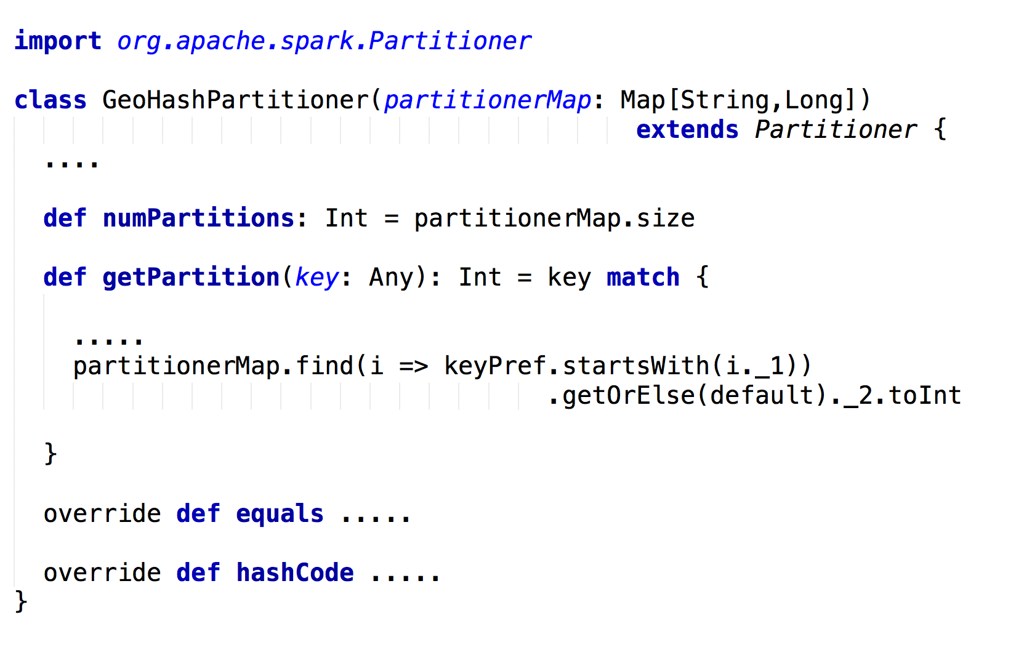

Slide 20
Arch1
Geo-Hash Partitioner
Re-calculate Hash for new load
Incoming Key value
(Geo-Hash)
Geo-Hash to
Partition
mapper
Hash to Partition data structure
Load Aware
Hash
Mapper
Geo-hash distribution
and load information
Geo-hash Key assigned
to its partition
Default Partitioning
Geo-Based Partitioning
m1
m2
World
Region with less data points
Region with a lot of data points ( > threshold)
Neighboring Region with less data
Smaller region with a lot of data points
Region with no data points
Notes:
7/13/16
20
20

Slide 21
Efficient Spatial processing with Spark
GeoHash Partitioner
GeoHash Query Layer
Notes:
7/13/16
21
21

Slide 22
Query act on all nodes
Normally executes code/query on all partitions of nodes
Large scans
Resource utilization
Notes:
7/13/16
22
22

Slide 23
GeoHash Query Layer
Leverage the knowledge of previous partitioning and efficiently query on subset of data:
Identify the type of Query
Determine the areas of interest from the overall world
Figure out partitions that contain our interested region
Slice out the partitions from the RDD
Push the query on the final RDD based on the Query predicates
Notes:
7/13/16
23
23

Slide 24
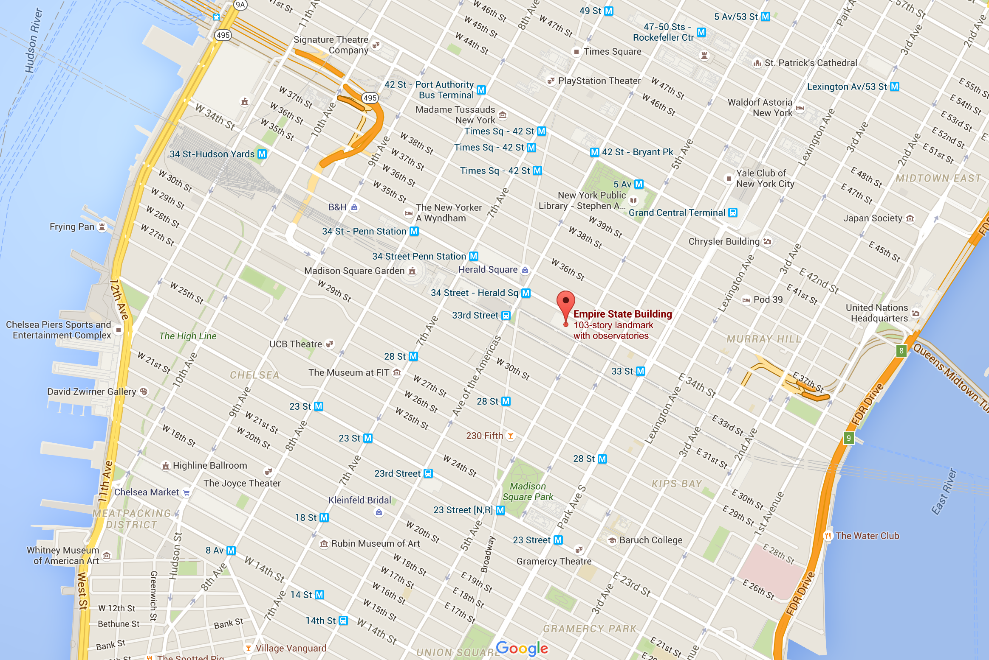

Notes:
7/13/16
24
24

Slide 25
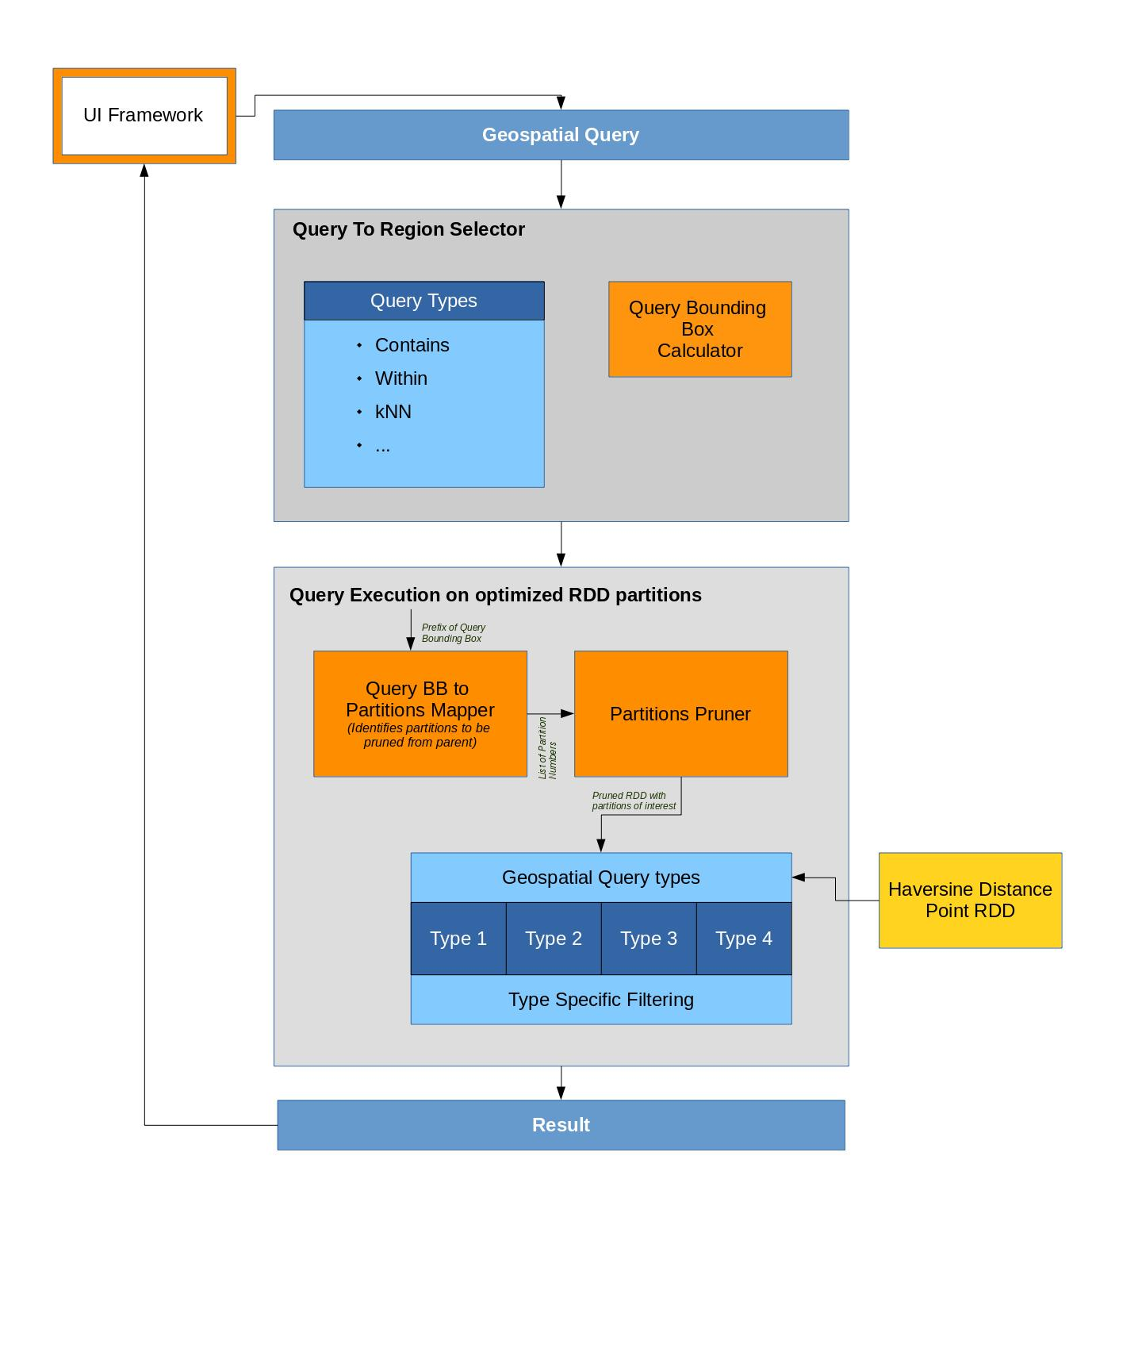
Arch2
Notes:
7/13/16
25
25

Slide 26
Evaluation Results
Notes:
7/13/16
26
26

Slide 27
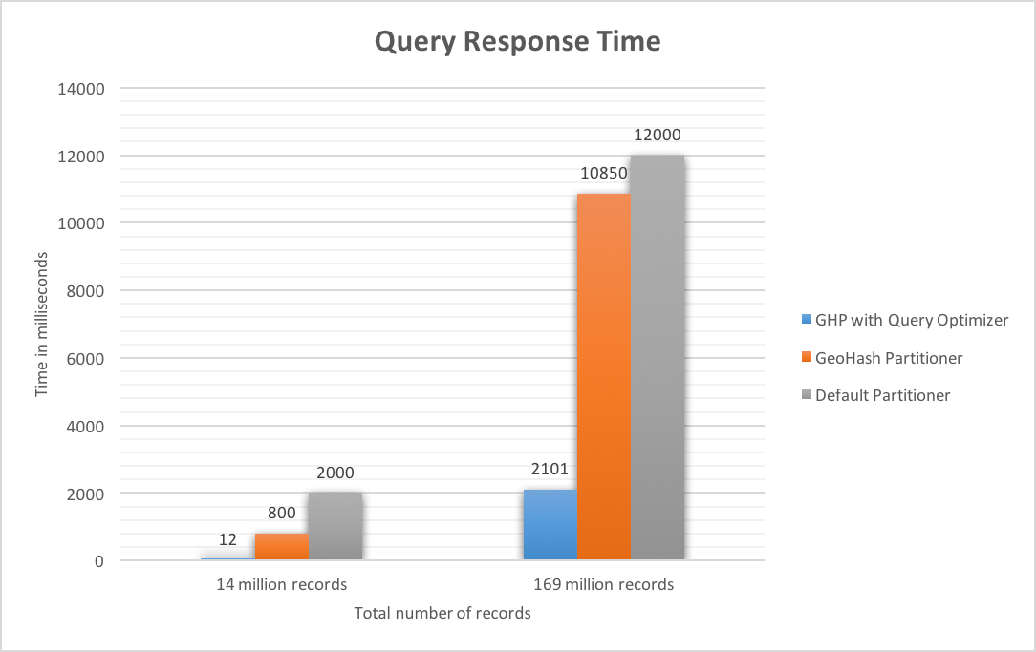
Improvement in Spatial Query Response time

Slide 28
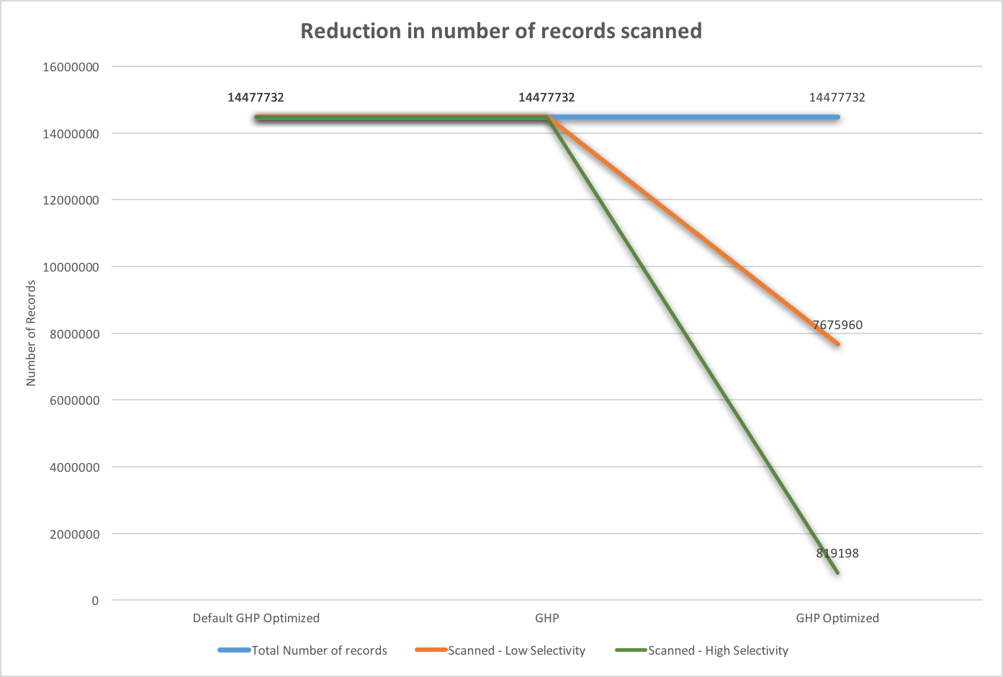
Reduction in number of records scanned

Slide 29
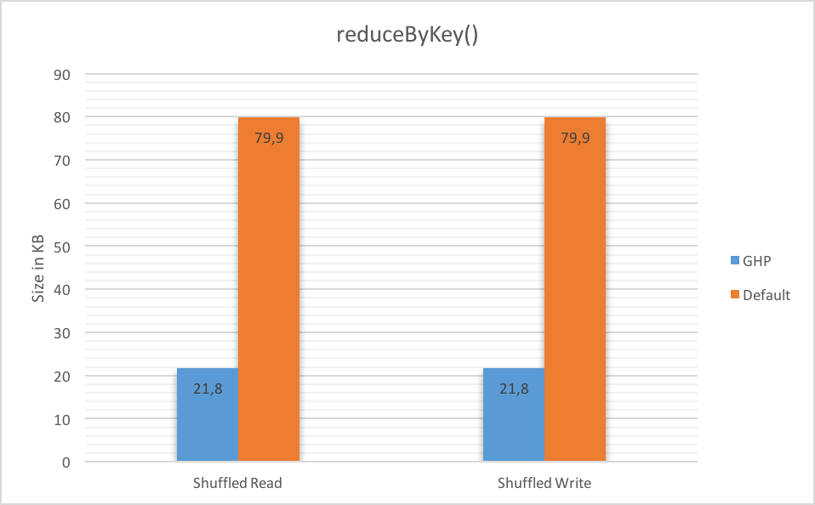
Reduction Locality of Spark tasks and minimized shuffling

Slide 30
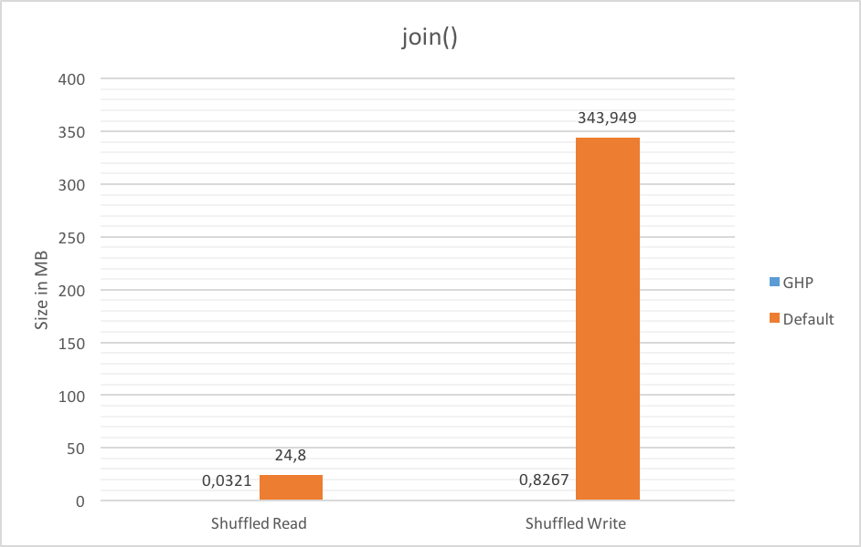
Reduction Locality of Spark tasks and minimized shuffling

Slide 31
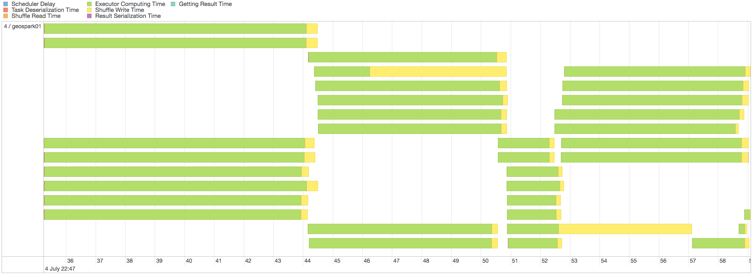
Reduction Locality of Spark tasks and minimized shuffling

Slide 32
Partitioning is not always beneficial: Benefits of Partitioning with multiple Reads

Slide 33
Limitations and Challenges
Inherent imbalance with Hashing
Need for minimizing scans during load balancing
Custom partitioner: Need to maintain metadata
Custom partitioner: Need to retain spark context

Slide 34
Project Details
Project page visit: http://hariharan-gandhi.github.io/thesis
Notes:
7/13/16
34
34

Slide 35
References
Facebook logo - https://www.facebookbrand.com/
Snapchat logo - https://www.snapchat.com/brand-guidelines
Twitter logo - https://about.twitter.com/company/brand-assets
Instagram logo - https://www.instagram-brand.com/
WhatsApp logo - https://www.whatsappbrand.com/
IBM logo - https://www-03.ibm.com/press/us/en/photo/20190.wss
Geotagging - http://smbp.uwaterloo.ca/wp-content/uploads/2014/07/geotagging.jpg
Map tile screenshot - ©2016 MapQuest http://open.mapquest.com/ | ©OpenStreetMap contributors - http://www.openstreetmap.org/copyright | ©Google Maps maps.google.com
Statistics: Location based service - https://wangxiaoyujade.wordpress.com/2015/02/25/location-based-service-groupon/ Source: Socintel360 as cited in company blog http://www.emarketer.com/
Statistics: mobile users - GSMA, “Gsma: The mobile economy 2016.” http://www.gsmamobileeconomy.com/
References last accessed: 12-July-2016
Notes:
7/13/16
35
35

Slide 36


